Slide 1
IMAT3613 Data Mining Lecture: Assessment

Slide 2
Lecture Learning Objectives
To be able explain what is meant by a lift chart.
To explain a response chart
To be able to explain confusion matrices.
To be able to assess Captured Response curve / Gains Chart
To be able to select Champion model.

Slide 3
Models set
Default partition Scheme.
You usually want as much data as possible for training set. More data the better learner
However trade off less data available to test set therefore less accurate measure of model performance on less unseen data
You don’t need a validation data, this may be optional
Validation data considered part of the training data.
Training 40%
Validation 30%
Test 30%

Slide 4
Model Set
Split the data set into 3 pieces
Training set, this is a pool of data which is used to uncover or learn relationships. We give the algorithm the answers it learns the rules. Model predictive performance is expected to be high we hope for 100% !
Validation set, this is a pool of unseen data that we use to optimise the algorithm, make a tweak to the algorithm measure the performance if improvement we keep it, if not discard the tweak. Model performance is usually worse than the training set. Used to chose the best model
Test set unseen data, data that is never been used to select or build a model. This gives you a measure of real world performance. Never used to select the best model
Data from the three partitions must be representative of eachother, ie same distribution of attribute properties in each partition. Sometimes this is difficult to achieve with a small sample of data

Slide 5
Comments on the model set
Up to the data miner to chose model set regime, this is determined by the amount of data you have available. If you have few data points your test set might be smaller. Make a judgement the defaults is a good starting point
Do not use the test data to select your best model, if you do you are using knowledge from “unseen” data to build a model You will underestimate the accuracy of your chosen model! The data is no long unseen.
In practice, in the implementation phase you may combine your training and test data to build a model that has learnt from all the possible data cases, however you will not be able to accurately reflect the performance of this model as you have no unseen data to test it on.
By comparing the performance of your model on the three different partitions you can judge if the model is overfitting. The performance of the validation data is far superior to the training set. We want to avoid this situation, indicates unreliable model. We expect training set > validation set > test set.
If you model is 100% predictive you have usually done something wrong, perhaps included a variable which closely corresponds to your target variable as an input. Effectively telling the algorithm what the answers are !

Slide 6
Metrics for Classification
Classification model performance usually described by
Response Charts
Lift Charts
Confusion Matrices
Captured Response Chart
ROC Charts

Slide 7
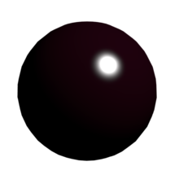
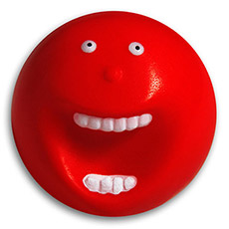
A data mining thought experiment
Target Variable
1 0
Notes:
Red ball represents the target variable

Slide 8




Example Response 20% or 1 in 5 red, bag containing 100 balls
Notes:
Bag represents model generation process for a binary classification problem
You cann’t look into it
Response which represents the base rate
100 balls to make it easier to calculate the numbers it’s a %

Slide 9


Randomise 100 balls in a bag
Random model
1 in 5 chance selecting
A red ball
For any 10 sample of balls
20% response, 2 will be red
Base line performance.

Slide 10

Lift value for a 3 samples size 10
0
Minimum Lift value
Lift = $\frac{\text{No} \text{of} \text{desirable} \text{events} \text{in} \text{sample}}{No of events expected at Random}$
1
Maximum Lift Value depends
upon the base line
5

Slide 11
Response for 3 samples size 10
Definition of Response
Response is the percentage of
Desirable events
Lift and Response are two ways of describing
The same outcome, slightly different
Contexts.
Lift value implies a knowledge of the
Base rate
0%
20%
100%

Slide 12
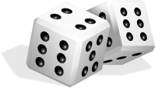



Generate data for a lift chart 1st model 100 balls
Decile | Desirable events | Cumulative desirable events | Non Cumulative Response % | Cumulative Response | Non Cumulative Lift | Cumulative Lift
1 | 0 | 0 | 0 | 0 | 0 | 0
2 | 2 | 2 | 20 | 10 | 1 | 0.5
3
4
5
6
7
8
9
10
Complete the third row

Slide 13

Generate data for a lift chart 1st model
Decile | Desirable events | Cumulative desirable events | Non Cumulative Response % | Cumulative Response | Non Cumulative Lift | Cumulative Lift
1 | 0 | 0 | 0 | 0 | 0 | 0
2 | 2 | 2 | 20 | 10 | 1 | 0.5
3 | 1 | 3 | 10 | 10 | 0.5 | 0.5
4 | 1 | 4 | 10 | 10 | 0.5 | 0.5
5 | 1 | 5 | 10 | 10 | 0.5 | 0.5
6 | 4 | 9 | 40 | 15 | 2 | 0.67
7 | 4 | 13 | 40 | 19 | 2 | 0.93
8 | 3 | 16 | 30 | 20 | 1.5 | 1.0
9 | 2 | 18 | 20 | 20 | 1.0 | 1.0
10 | 2 | 20 | 20 | 20 | 1.0 | 1.0

Slide 14
Graph It Response Chart
0% Response at 10% depth, 10% response at 20% depth,
model performs worse than random
This model has zero scope ! Its performance never beats the baseline

Slide 15
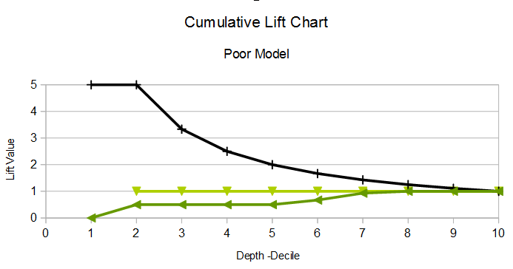
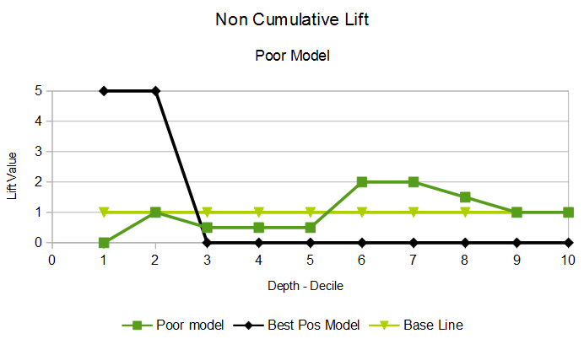
Graph It Lift Chart
Indicates
unreliable model
Even though lift
Value > 1
0 Lift at 10% depth, 0.5 lift at 20% depth
This model has zero scope ! Its performance never beats the baseline

Slide 16
Generate data for a lift chart 2nd model 100 balls
Decile | Desirable events | Cumulative desirable events | Non Cumulative Response % | Cumulative Response | Non Cumulative Lift | Cumulative Lift
1 | 9 | 9 | 90 | 90 | 4.5 | 4.5
2 | 7 | 16 | 70 | 80 | 3.5 | 4.0
3
4
5
6
7
8
9
10

Slide 17



Generate data for a lift chart 2nd a good model
Decile | Desirable events | Cumulative Desirable Events | Non Cumulative Response % | Cumulative Response | Non Cumulative Lift | Cumulative Lift
1 | 9 | 9 | 90 | 90 | 4.5 | 4.5
2 | 7 | 16 | 70 | 80 | 3.5 | 4.0
3 | 2 | 18 | 20 | 67 | 1 | 3.0
4 | 2 | 20 | 20 | 50 | 1 | 2.5
5 | 0 | 20 | 0 | 40 | 0 | 2.0
6 | 0 | 20 | 0 | 30 | 0 | 1.7
7 | 0 | 20 | 0 | 29 | 0 | 1.4
8 | 0 | 20 | 0 | 25 | 0 | 1.3
9 | 0 | 20 | 0 | 22 | 0 | 1.1
10 | 0 | 20 | 0 | 20 | 0 | 1.0

Slide 18
Cumulative Response
Model performance 65% response at a depth of 30%
Or 80% response at depth of 20%

Slide 19
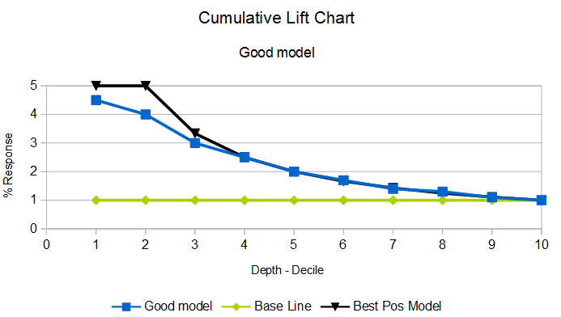
Cumulative Lift
Alternatively model performance is approx 3 times better than random
At depth of 30%, or 4 times better than random at 20%

Slide 20
Non-Cumulative Response
Model Scope 30% depth, the
point at which the model is no
longer predictive

Slide 21
Comments
First model is unrelieable, cumulative lift curve never rises above the base line
The model has zero scope, even though for samples 6-7 the model has correctly identified the target class. This is symptomatic of an unreliable model
Second model has good performance, close to the theoretical maximum, better than the baseline.
The second model can be used upto a depth of 30% and it still predictive. If you had a test set of 1000 observations you would chose the first 300 observations.

Slide 22
General Points
When choosing a model you want a reliable lift curve, steady decrease down to the baseline at 100% depth.
No spikes and above the baseline, no rise and fall below the baseline
Pick the one with the highest lift value and the most scope.
Avoid using lift values at less than a depth of 10%, that will be a small number of observations. You may have to increase the size of your test set! for your chosen model to be predictive, if you are required to pick a specific number of observations. ie if require 600 prospects, double the size of the test set or increase the pool of observations

Slide 23
Conclusions
Always make comparisons with the baseline model and best possible model.
Calculate the baseline and the maximum theoretical attained lift value.
Any model better than the baseline is useful !
Some models are more useful than others !
Any model worse than the baseline is worthless
With lift charts the “cream floats to the top” observations which are ranked lower down in list are less likely to be of interest.
Lift / Response charts allow you to filter the test set for the most likely candidates.

Slide 24
Confusion Matrices
Lift / response charts give provide a picture of mode performance for a certain depth % test set
Confusion Matrices or diagnostic charts or sometimes called classification charts provide a measure for screening for the whole of the validation set.
Both charts are usually considered together when selecting the champion model
Confusion Matrices allow you to focus on the accuracy and different types of error in your model

Slide 25
Not all Errors are equal
Event =1
NonEvent =0
True Negatives – number of correct 0s
True Positivies – number of corrects 1s
False Positives – number of predicted 1s that are in fact 0 – error - ie you have tested +ve for cancer put you are healthy
cost : you will receive unnecessary surgery – pain discomfort
False Negatives - number predict 0s that are in fact 1s – error –ie you have tested -ve for cancer but are predicted to be unhealthy and have cancer
cost : will not receive the intervention - lost years of life

Slide 26
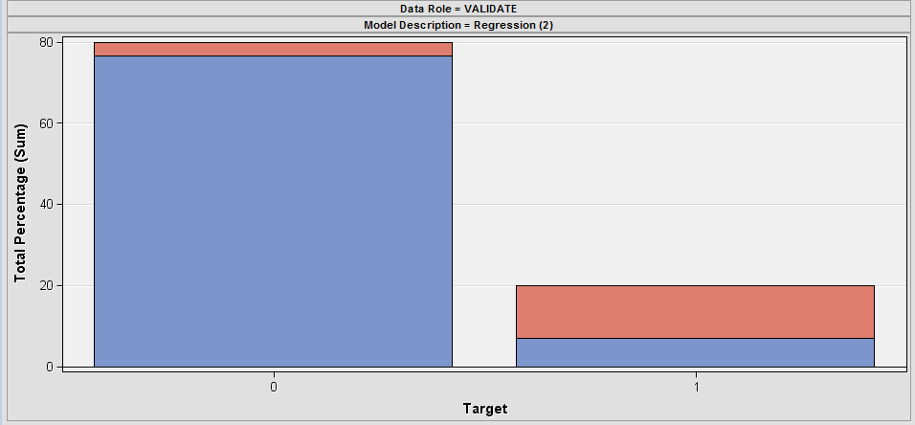
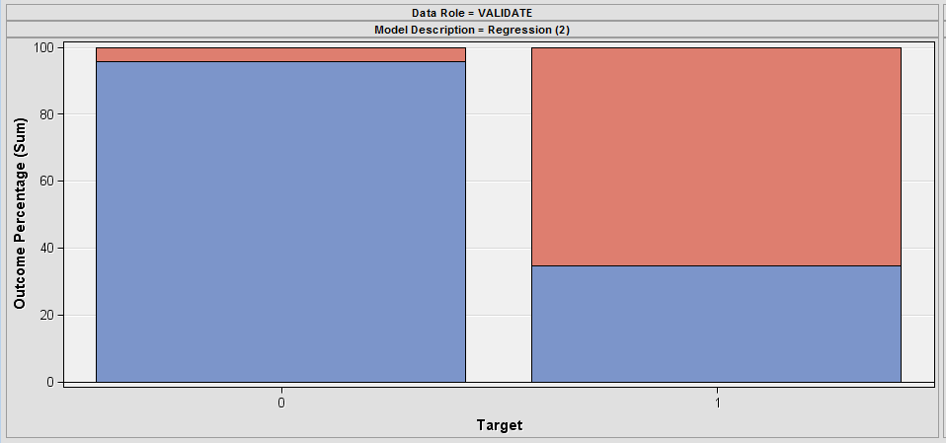
Graphically – Response of Target Variable Normalise to 100%

Slide 27
Labels Classifcation Chart
233 False Negatives out of 357
65.3%
61 False Positives
out of 1431
4.3 %
1370 True Negatives out of 1431
95.7%
124 True Positives out of 357
34.7%

Slide 28
Another Layout
Full Regression with Replacement model classifications REG 2 % |  | Actual Target
 |  | 0 | 1
Predicted Target | 0 | 98.9 | 73.2 (false -ve)
 | 1 | 1.0 (false +ve) | 26.8
Total |  | 100 | 100
0,0 represents true negatives (TN)
1,1 represents true positives (TP)
0,1 represents BAD payers who were incorrectly assigned to be good payers, ie the guilty go free. (FN)
1,0 represents false positives, ie incorrectly assigned Bad payers who turn out to be good payers, ie punishment of the innocent (FP)
Make sure you know which order your axis are ! Actual and predicted columns could be flipped which reverses the the location of FN and FP

Slide 29
Another Layout
Full Regression with Replacement model classifications REG 2 % |  | Predicted Target
 |  | 0 | 1
Actual Target | 0 | 98.9 | 1.0 (false +ve)
 | 1 | 73.2 (false -ve) | 26.8
0,0 represents true negatives (TN)
1,1 represents true positives (TP)
1,0 represents BAD payers who were incorrectly assigned to be good payers, ie the guilty go free. (FN)
0,1 represents false positives, ie incorrectly assigned Bad payers who turn out to be good payers, ie punishment of the innocent (FP)
Make sure you know which order your axis are ! Actual and predicted columns could be flipped which reverses the the location of FN and FP

Slide 30
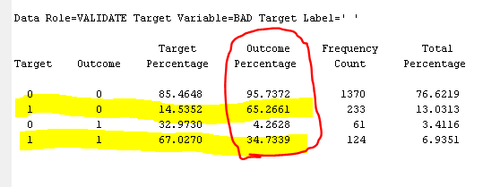
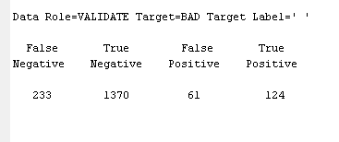
Output file for Classificaiton Models

Slide 31
Metrics from a Confusion Matrix
Precision
TP / (FP +TP)
124 / (61 + 124) = 0.6702 = 67.02%
Accuracy
(TN + TP) / ( FN + TN + FP + TP)
(1370 + 124) / (233 + 1370 + 61 + 124) = 83.56%
Misclassification Rate
(FN + FP) / (TP + TN + FP + FN)
(233 + 61) / (233 + 1370 + 61 + 124) = 16.44%

Slide 32
Evaluation
Ideally select the model with the highest accuracy and lowest error
If they have the same performance in either accuracy or error, select the one that produces the most profit, normally the one with the most TP however
Identify the model whose error is least costly, whether that be FP or FN, this depends upon the context of the business problem

Slide 33
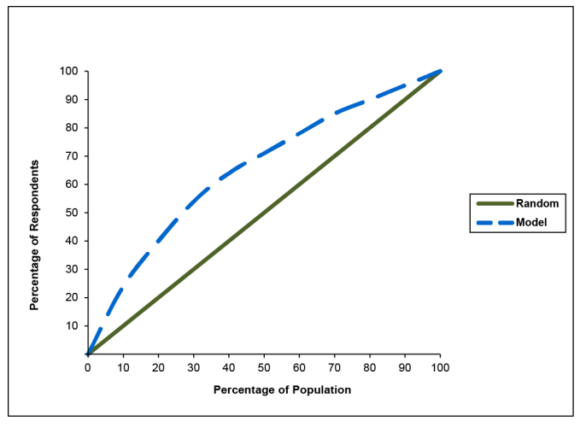
Captured Response Chart “looks like ROC” careful check axis !

Slide 34
Notes
Excellent visualisation tool for showing the power of a model.
Cumulative % of each target group for each decile
For example in previous chart for 50% of the test data you have captured 70% of the response.
This represents an almost 50% increase over random
Easy to see the benefit of the impute node HMEQ example
Gains Charts are not produced by default in SAS

Slide 35
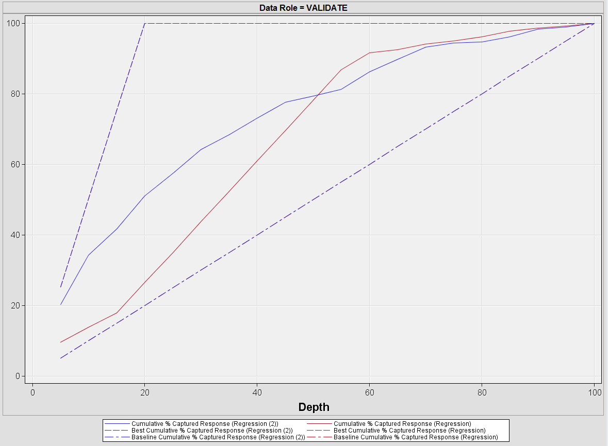
For Example HMEQ
2.5 times random for 20% of the data
Regression without impute almost performs
The same as random

Slide 36
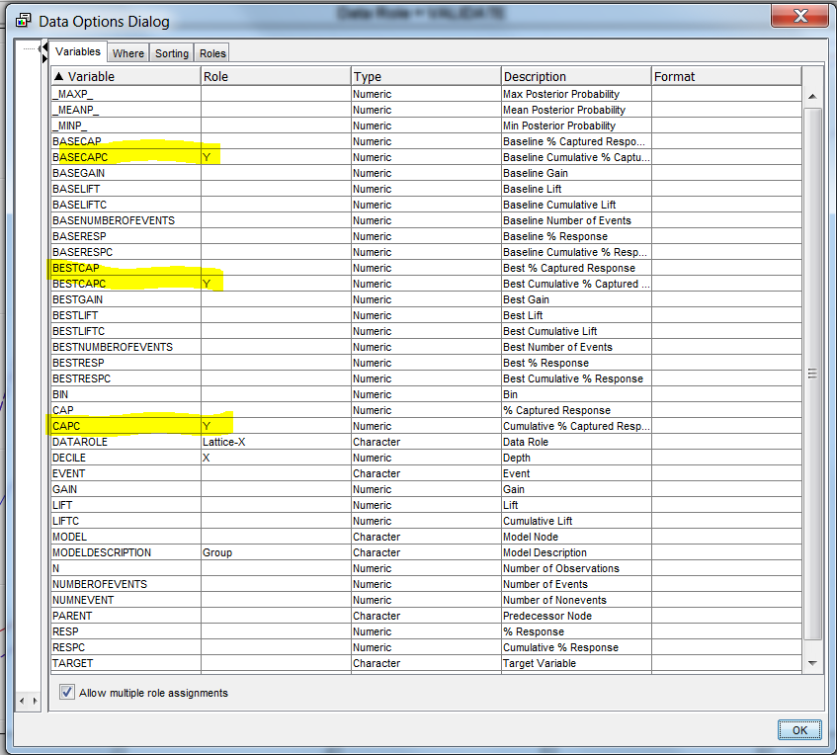
Sas data options settings on lift chart

Slide 37
Recall data from earlier thought experiment, target 20 red balls
Decile | Poor Model Cumulative desirable events | Poor model Fraction of Target Response (/20) | Good ModelCumulative Desirable Events | Good Model Fraction of Target Response (/20) | Random Model | Best Pos Model
0 | 0 | 0 |  | 0 | 0 | 0
1 | 0 | 0 | 9 | 0.45 | 0.1 | 0.5
2 | 2 | 0.1 | 16 | 0.8 | 0.2 | 1
3 | 3 | 0.15 | 18 | 0.9 | 0.3 | 1
4 | 4 | 0.2 | 20 | 1 | 0.4 | 1
5 | 5 | 0.25 | 20 | 1 | 0.5 | 1
6 | 9 | 0.45 | 20 | 1 | 0.6 | 1
7 | 13 | 0.65 | 20 | 1 | 0.7 | 1
8 | 16 | 0.8 | 20 | 1 | 0.8 | 1
9 | 18 | 0.9 | 20 | 1 | 0.9 | 1
10 | 20 | 1 | 20 | 1 | 1 | 1

Slide 38
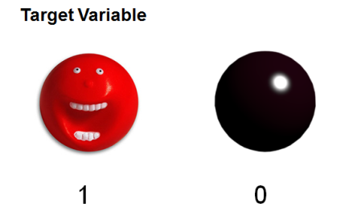
Captured Response Chart Poor vs Good Model
Good Model
performance
Poor Model
performance

Slide 39
ROC (avoid use captured response chart)
Receiver Operator Curves
Signal detection theory to characterise hit rate and false alarm rate over a noisey channel. Developed from RADAR technology.
Plot of TP rate vs TN rate for a sample
Measurement level 1 vs 0
TP rate = TP/(TP +FN) x 100
Proportion of correct predictions for target class =1
1-FP Rate = 1 - FP/(FP+TN) x 100
1- Proportion of incorrect predictions for target class =0
When class 0 what proportion is actually predicted be 0
You want High TP, low FP rate however normally a trade off
Software generates the graph for you at this level details not important

Slide 40
Qualative Analysis
The diagonal line represents base line
Any Curve above the baseline is predictive
The closer the curve is to 0,1 upper lefthand-side the better the model
Can be quantified by area under the curve AUC.
Compare train, validation and test – indicate reliability of the model
When comparing models use the validation data, select one with highest AUC

Slide 41
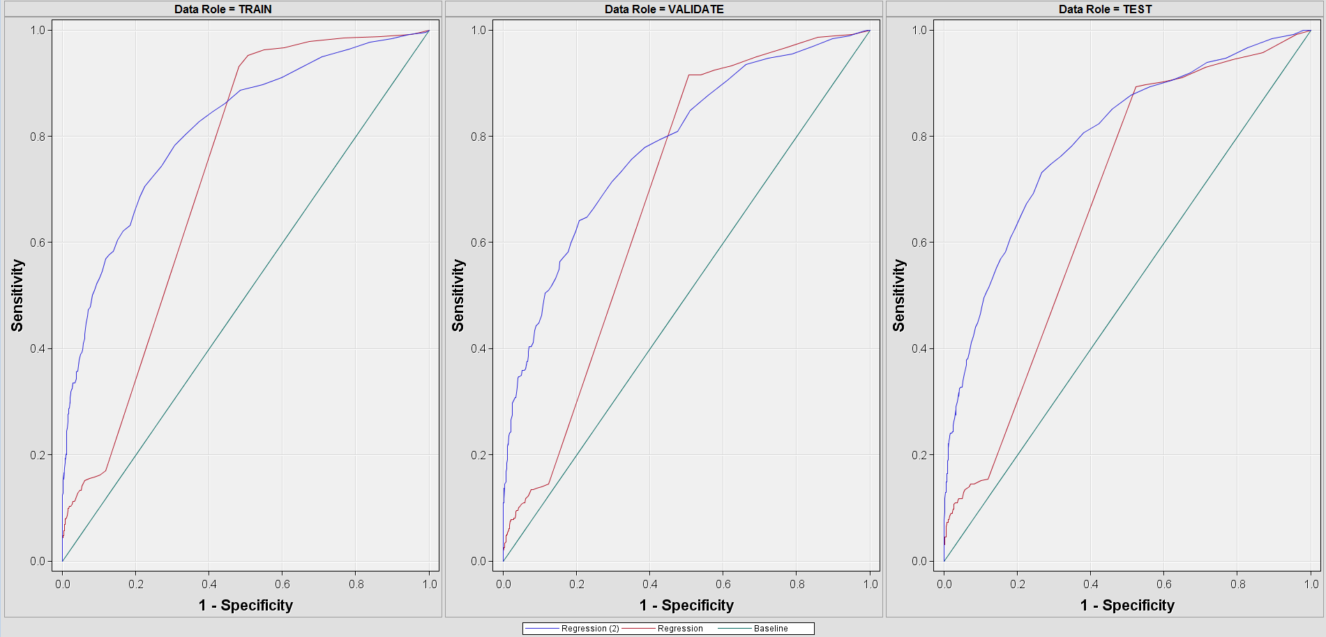
ROC Example – Comparison node
Ideal Region
Random

Slide 42
ROC Summary
Used to trade off false positives and false negatives, at different thresholds values
No documented how SAS generates these charts, look similar to captured response chart.
Diagonal line performance random model
Area under the curve – occupy as much of the area towards upper left hand corner
Sensitivity y axis
Specify x axis

Slide 43
Additional
ROCs can be modified to treat ordinal target variables
Estimation methods use Mean Average Error, AIC or BIC
Lower the better the model
Can allow for unbalanced data
Can use cost matrices to penalise FP over FN
Can penalise model complexity, number of terms, pick the simpler model. MDL

Slide 44
Summary
You should now:
Know how to interpret
Lift Charts
Response Charts
Both variants cumulative non-cumulative
Identify scope of a model
Confusion Matrices/diagnostic charts
Qualitatively describe Captured response charts
Arrive at a champion model considering
Performance
Error
Limitations
Model complexity
Explainability

Slide 45
Background reading
Berry Michael JA and Linoff Gordon S (2004). Data Mining Techniques. 2nd ed. Wiley. Pp71-86, 98
Olivia Rud-Par, 2009) Business Analytics using Enterprise Guide and Enterprise Miner, p 60
Ian H Witten, Eibe Frank and Mark A Hall (2011), Data Mining: Practical Machine Learning Tools and Techniques. 3rd ed.Elsevier. Pp147-156

Slide 46



Calculate TP and FP rate
The good model
TP rate = TP/(TP +FN) x 100
Proportion of correct predictions for target class =1
FP Rate = FP/(FP+TN) x 100
Proportion of incorrect predictions for target class =0
TP 16/16+4 (0.8)
FP 4/20 (0.25)
Where as Poor model
data set TPR 0.2
FPR 0.8

